Slide 1
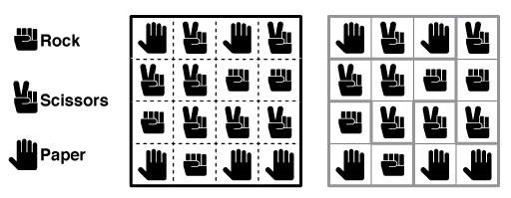
Rock Paper Scissors Game in C++
This presentation will walk you through the implementation of a Rock Paper Scissors game in C++.

Slide 2
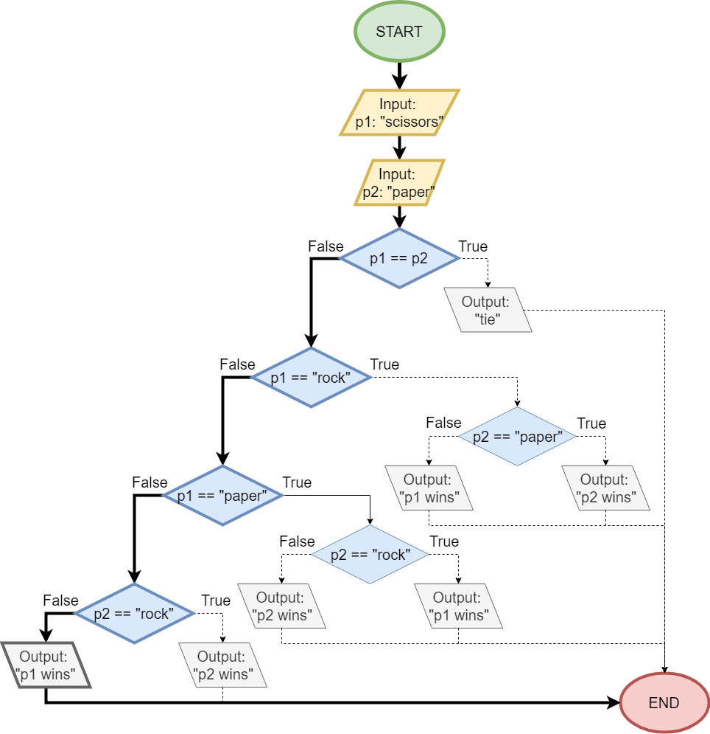
Game Logic
User inputs their choice (Rock, Paper, or Scissors)
Computer generates a random choice
Game determines the winner based on the game's rules

Slide 3
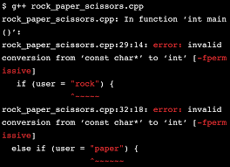
Code Implementation
Highlights and Explanations
1. User Input: cin >> user; - Gets the user's choice (1-3) for Rock, Paper, or Scissors.
2. Computer Generation: computer = rand()%3+1; - Generates the computer's random choice (1-3) for Rock, Paper, or Scissors.
3. Game Logic: The if-else statements determine the winner based on the user's and computer's choices.

Slide 4
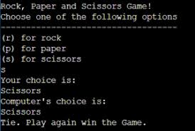
Key Features
- User-friendly interface
- Random computer moves
- Scoring system
- Option to play again
The Rock Paper Scissors game is a simple yet engaging project that demonstrates basic C++ concepts. With its scoring system and option to play again, it provides a fun and interactive experience for users.

